Slide 1

Australia Int’l Trading report
Time series (1987 – 2019) Data visualization:
when, where to buy or sell, and values.

Slide 2

Codding road MAP
D3
GEOJSON
& JSON
Flask API tested
JS
HTML
GO
Leaflet
CSS
New JS function deployed
PostgreSQL
Pandas
Json
MongoDB
CSV and Geojson

Slide 3
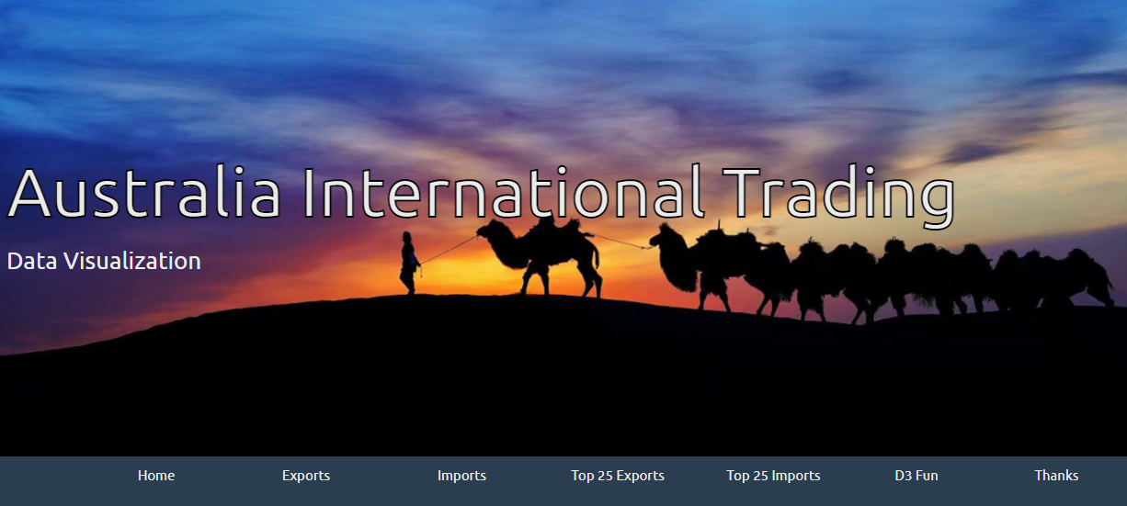
Index Page

Slide 4
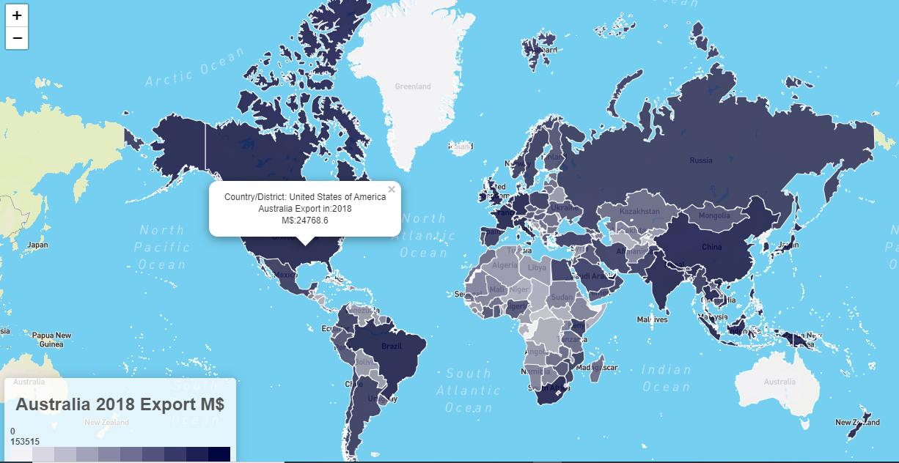
Export Chart for 2018

Slide 5
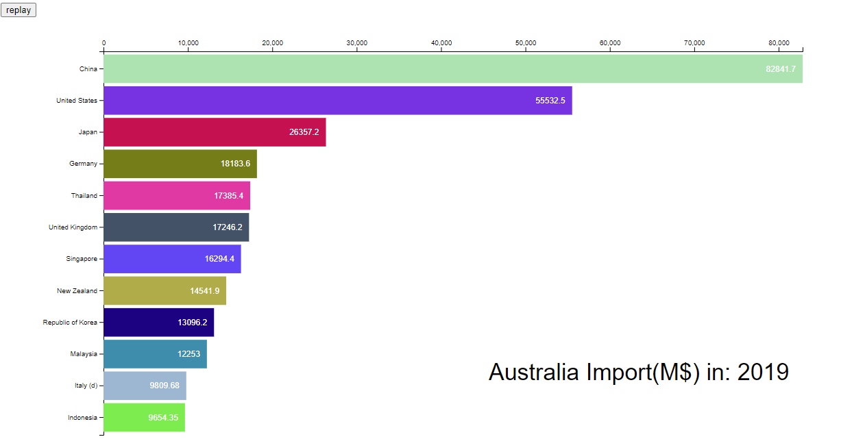
Import chart for 2019

Slide 6
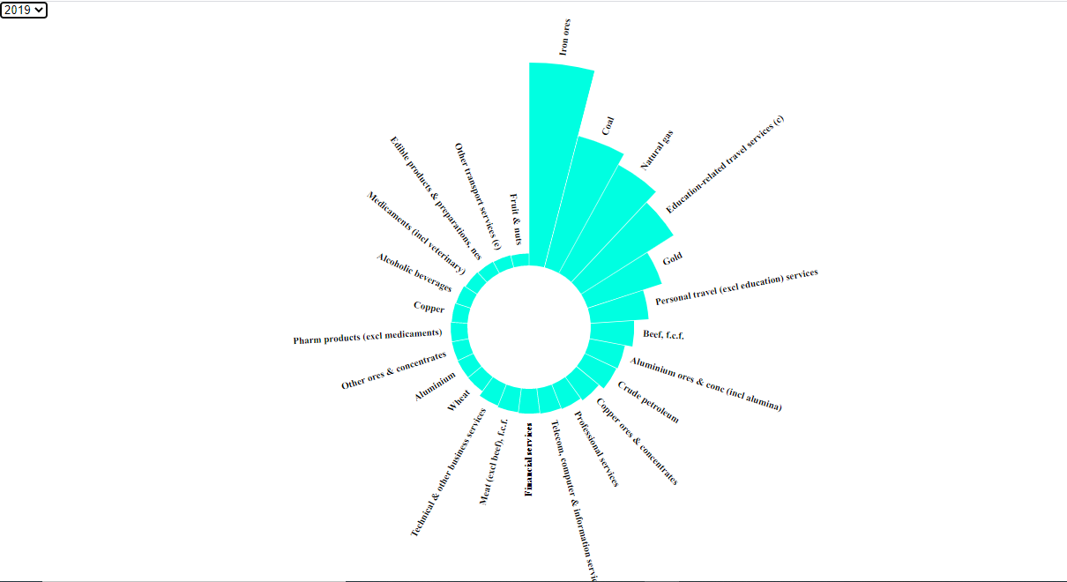
Top 25 export commodities 2019

Slide 7
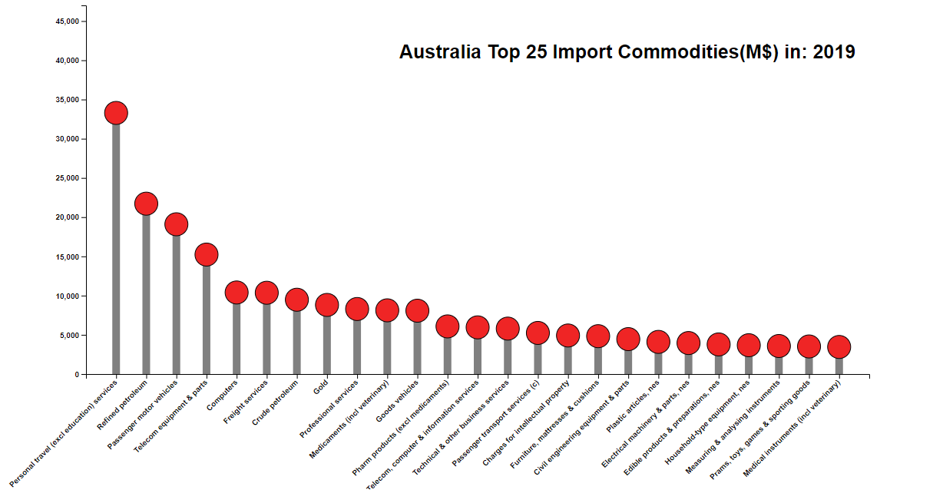
Top 25 import commodities

Slide 8

Thanks and question time

Slide 9


This is my projection 2, with DATA BOOT CAMP / UWA
Thank you very much for your attention & comments/questions.
Happy to answer your questions.
TONY
ZHAO
01/05/
2021

